Slide 1
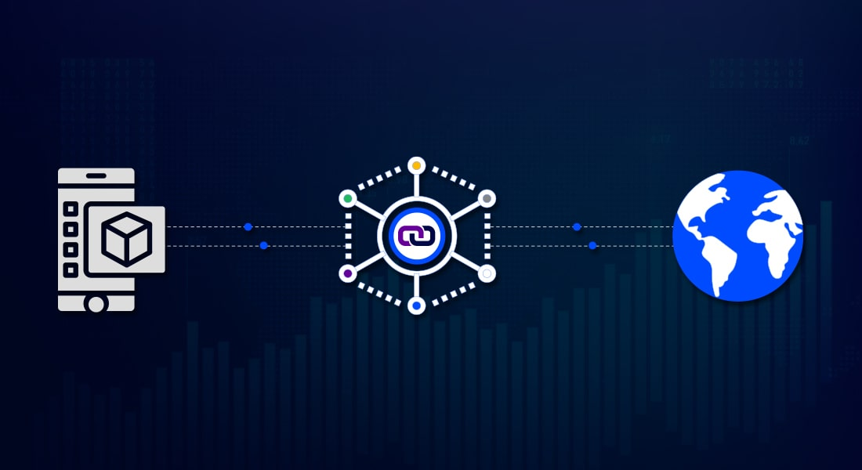
ORACLES
Blockchain technologies, lecture 4
Notes:
NOTĂ:
Pentru a modifica imaginea de pe acest diapozitiv, selectați-o și ștergeți-o. Apoi faceți clic pe pictograma Imagini din substituent pentru a insera propria imagine.

Slide 2
Course overview
Oracles
Blockchain middleware, general concepts
Oracle's problem: decentralization and security
Oracles design patterns
Case study: Chainlink architecture
Case study: Oraclize or Provable Things

Slide 3
ORACLES

Slide 4
ORACLES access off-chain data
Third party services that provide smart contracts with external information.
Broaden the scope in which smart contracts operate.
Oracles classification:
Source: hardware, software or human
Software Oracles (deterministic oracles) transmit information from online databases, servers, websites etc.
Hardware Oracles: translates real-world events in information that can be understood by smart contracts; sensors; Supply Chain applications
Human oracles, cryptographically identified, transmit respond to arbitrary inquires.
Direction of information: inbound or outbound
Trust: centralized or decentralized

Slide 5
ORACLES provide data and off-chain computations
Data feeds that connect blockchain to off-chain information.
Inbound or outbound
Inbound oracles transmit information from external sources to smart contracts
Temperature measured by a sensor
Outbound oracles send information from smart contracts to the external world.
Smart lock: outbound oracle receives information from smart contract to unlock the smart lock.

Slide 6
ORACLES provide data and off-chain computations
Data feeds that connect blockchain to off-chain information.
Applications:
payments;
exchange rates, decentralized finance (DeFi) applications;
predictions, bets;
weather reports (insurance calculations);
Output Oracles: IoT sensors for supply chain;
Dynamic NFTs, gaming, verifiable randomness (fairly select a winner in a lottery);
Insurance smart contracts etc.

Slide 7
ORACLES provide data and off-chain computations
Data feeds that connect blockchain to off-chain information.
Scale blockchain: off-chain computations
Functionalities:
Receives requests from smart contracts;
Send data to external systems;
Extract data;
Compute: verifiable RNG, aggregate data etc.;
Format data in blockchain compatible formats;
Validate: zero-knowledge proofs, Trusted Execution Environment (TEE) attestations, TLS signatures etc.

Slide 8
ORACLE PROBLEM

Slide 9
ORACLES access off-chain data
Data feeds that connect blockchain to off-chain information.
Blockchain: deterministic transactions, same result on every node, independent of the moment in time the transaction is processed.
API calls may result in different results and in the impossibility to reach consensus.
An oracle records the result of calling an external API through a blockchain transaction (blockchain middleware).
Typically, an oracle is a smart contract accessing some of-chain components that can query APIs.

Slide 10
ORACLES centralized/decentralized
Smart-contracts cannot directly interact with data existing outside blockchain environment.
Centralized oracle: single point of failure.
Security risks (who controls the API?).
Blockchain immutability: faulty data cannot be reversed.
Solutions:
Decentralized Oracle (DON – decentralized oracle network) combines multiple data sources and multiple independent oracles.
prove data validity

Slide 11
ORACLES centralized/decentralized
Solutions:
Decentralized Oracle (DON – decentralized oracle network) combines multiple data sources and multiple independent oracles.
Requires predefined standard data format.
Inefficient, gathering answers from multiple sources requires time.
Data providers may require fees.
prove data validity:
No need to trust the oracle
Data providers don’t have to modify services in order to become compatible with Blockchain technologies.
Decentralized oracles distribute trust between many participants.

Slide 12
ORACLEs DESIGN PATTERNS

Slide 13
ORACLES centralized/decentralized
Key functionalities:
Collect data from off-chain source
Transfer the data on-chain with a signed message.
Store the data in a smart contract’s storage.
Once the data is available in a smart contract’s storage, it can be accessed via message calls.
Immediate-Read oracles:
Examples: data about persons/organizations, data issued by organizations.

Slide 14
ORACLE design patterns
Publish-subscribe pattern.
Data is expected to change frequently: prices, weather, traffic data etc.
Similar to RSS feed.
Subscribers listen to oracle contracts updates.
In Ethereum: event logs, can be considered “push” service.
Publishers categorize messages into classes. Subscribers may express an interest in one or more classes.

Slide 15
ORACLE design patterns
Request-response pattern.
Data can’t be stored in a smart contract.
On-chain smart contract and off-chain infrastructure.
Requests include scheduling parameters and callback functions.
The Oracle may require payment for processing the request.

Slide 16
ORACLE design patterns
Request-response pattern.
Oracles receives a query from a Dapp with arguments detailing the data requested, callback functions and scheduling parameters.
Parse the query
Check payment
Retrieve data from off-chain source and encrypt it if necessary.
Broadcast the transaction to the network.
Schedule any further necessary transactions.

Slide 17
Blockchain
Smart contract
request (request_type,
scheduling_parameters, callback_function)
Oracle
response via
callback function
External data

Slide 18
orACLIZE/Provable Things

Slide 19
ORACLIZE/Provable Things
Serves requests on platforms like: Ethereum, R3 Corda, Hyperledger Fabric, EOS etc.
Operates since 2015.
Solution to oracle problem: demonstrate data authenticity and validity.
Data is return together with an authenticity proof. (no need to trust the oracle).
Authenticity proofs use different technologies, auditable virtual machines and TEE.
Can be integrated with both private and public instances of blockchain protocols.

Slide 20
ORACLIZE/Provable Things
Provable engine will execute a given set of instructions if some other given conditions are met.
“If This Then That” logical model.
Servs both blockchain-based and non-blockchain-based applications.
Provable engine ensures a synchronous communication between on-chain smart contract and off-chain external data sources.
On-chain smart contract executes two transactions:
Call request to oraclize engine
Callback function call by oraclize engine.

Slide 21
ORACLIZE/Provable Things
Authenticity proofs:
TLSNotary proofs, collection of digital signatures
Can be delivered to the smart contract or stored on IPFS.
Provable data source types: websites or API:
URL
WolframAlpha
IPFS
Computation

Slide 22
ORACLIZE/Provable Things
IPFS
P2P storage network
Content addressing:
identify content and not locations (what you seek instead of where to seek)
every content that uses the IPFS protocol has a content identifier (CID) or hash.
Uses Merkle DAGs: similar files share parts of Merkle DAG
Lookups: Distributed hash table DHT and Kademlia.

Slide 23
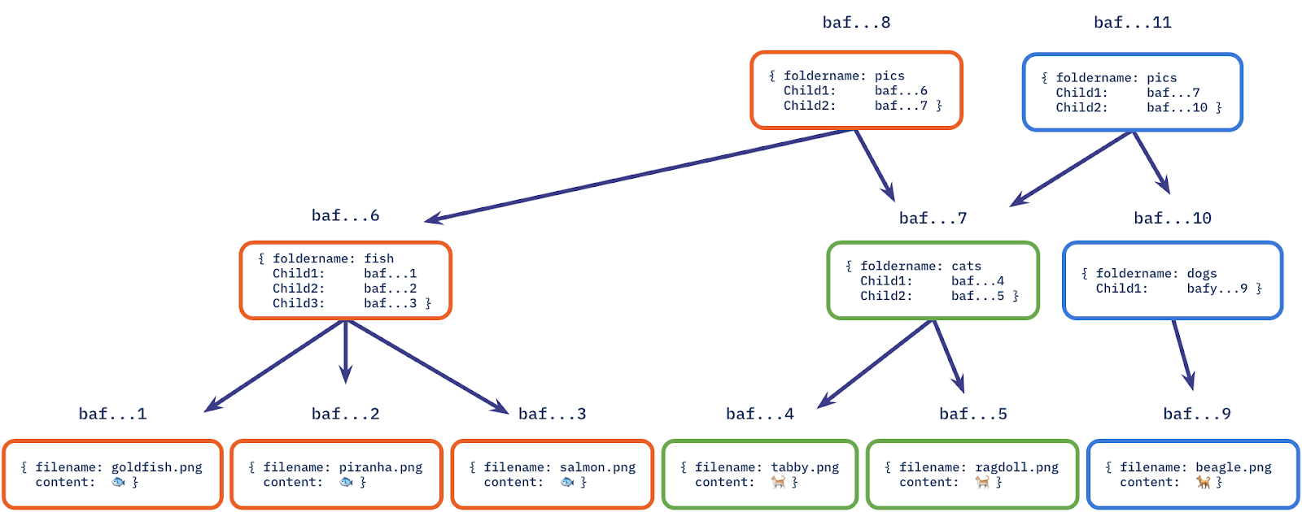

Slide 24
ORACLIZE/Provable Things
A valid request to Provable should specify the following arguments:
Query
Data source type
Authenticity proof type (optional)
Query parameters:
First parameter mandatory: expected URL where the resources is to be found, if it’s the only argument present, the HTTP GET is requested;
Optional parameters: data payload of the HTTP POST request;
Parsing helpers optional.

Slide 25
ORACLIZE/Provable Things
Data Source Types: a trusted provider of data, website, web API, a secure application running on a hardware-enforced Trusted Execution Environment (TEE) a virtual machine instance running in a cloud provider etc.
Native Data Sources:
URL enables access to any webpage or HTTP API endpoint
WolframAlpha access to WolframAlpha computational engine
IPFS access to content stored on IPFS
random provides random bytes coming form secure application running on a Ledger Nano S
Computation provides result of arbitrary computation

Slide 26
CHAINLINK

Slide 27
Chainlink
USER-SC Requesting contract.
CHAINLINK-SC On chain contract responding to USER-SC requests.
Adapter: interface with CHANLINK-SC on-chain smart and workloads across external services.
Main components:
Reputation contract:
Order-matching contract
Aggregating contract

Slide 28
Chainlink
Reputation contract: keeps record of the service provider performance metrics.
Incentivize and penalize reporting contracts
Order-matching contract: delivers the request to Chain-link nodes and take their bids on the request and select the number and the types of nodes to fulfill request
Aggregating contract: calculates weighted answer. The validity of each response is reported to the reputation contract.
Requesting contract pay with LINK built in accordance with ERC-20 standard.

Slide 29
Bibliography
https://fravoll.github.io/solidity-patterns/oracle.html
https://wp.antlia.io/wp-content/uploads/2021/07/Blockchain-oracle-min.jpg
Abdeljalil Beniiche A study of Blockchain Oracles https://arxiv.org/pdf/2004.07140.pdf
https://faucets.chain.link/rinkeby
https://tlsnotary.org/TLSNotary.pdf
https://docs.provable.xyz/#home
https://ieeexplore.ieee.org/stamp/stamp.jsp?arnumber=9086815
https://docs.ipfs.io/concepts/how-ipfs-works/
https://github.com/tiulia/web3-social-media-dApp/

